Slide 1
ELECTRONICS AND INSTRUMENTATION ENGINEERING
Virtual Reality for Process Training in Industrial Applications
BHARATHI S
GOWSIKA N

Slide 2
PROBLEM STATEMENT :-
Industries require effective training solutions for complex machinery and processes to ensure workforce competency, safety, and operational efficiency. This project aims to implement a VR-based industrial process training system to enhance knowledge retention, reduce training costs, and improve workforce safety. By integrating VR technology, industries can accelerate skill development, minimize risks, and optimize training effectiveness.
Virtual Reality (VR) offers an innovative solution by providing interactive, real-time simulations of industrial environments. This allows trainees to practice operations, maintenance, and safety protocols in a controlled setting without real-world consequences. VR system will provide immersive and interactive simulations of industrial equipment, machinery, and processes, enabling trainees to practice and refine their skills in a safe, controlled, and risk-free environment.

Slide 3
OBJECTIVE :-
VR provides realistic, hands-on simulations that improve knowledge retention and skill development.
Trainees can make mistakes in a safe, virtual environment without real-world consequences.
VR training reduces the need for physical resources and minimizes downtime.
VR training can be easily scaled and delivered across multiple locations, ensuring consistent learning.

Slide 4
Required Components:-
Head-Mounted Display (HMD)
Motion Controllers
Tracking Sensors
High-Performance PC or VR-Ready System
Haptic Feedback Devices
Simulation Software
3D Models and Virtual Environments
Cloud-Based Servers
Learning Management System (LMS)

Slide 5
PROCEDURE AND STEPS :-
Hardware Selection -VR Headset, Controllers, PC Requirements (if using PC-based VR)
Design the VR Environment –factory, switches, cables, panels, short circuits, electric shocks
Develop Core Features -Electrical Hazard Identification, Training Modules
Test & Optimize - Beta Testing, Bug Fixing
Deployment & Updates - Enterprise Version, Future Updates

Slide 6
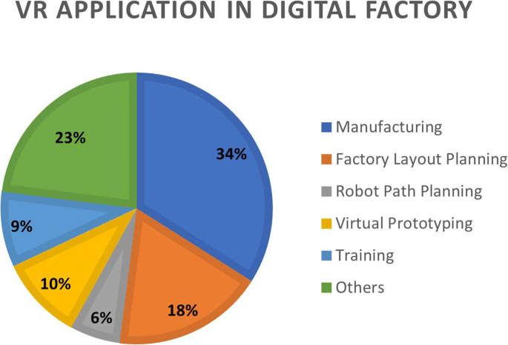


Slide 7
Benefits of the Project
Safe Training Environment – Users can experience hazardous scenarios without real-world risks.
Better Knowledge Retention – Interactive learning improves engagement and memory.
Cost-Effective – Reduces the need for physical training setups.
Scalable – Can be used for training multiple workers across industries.

Slide 8
Potential Applications:-
Industrial and factory safety training.
Electrical engineering student learning programs.
Power plant and substation worker training.
Construction site safety awareness.
Advantages:-
Cost Saving
Improved Safety
Faster Problem-Solving

Slide 9
Conclusion
In conclusion, implementing VR in industrial projects offers significant benefits, including enhanced training, cost savings, improved safety, faster problem-solving, increased efficiency, and enhanced collaboration. These advantages contribute to a more productive, safer, and cost-effective industrial environment, ultimately driving innovation and progress in the sector.

Slide 10


